Slide 1
IT Asset Management
General Information
Notes:
1

Slide 2
IT Asset Management introduction
Learning objectives
  At the end of this course, you will have gained the knowledge and skills to:
    Understand the basic ITAM disciplines, concepts and definitions
    Understand the ITAM issues and challenges
    Understand how they can benefit your organisation - from a financial, IT service and end user point of view
    Understand the 4 key areas and how they relate
    Understand the workflow and the key roles in the management of your IT assets
    Relate the ITAM work frame to your organisational key business drivers

Slide 3
Present yourself
Introductions
  We would like to get to know you. Please share with the class:
    Your name
    Your profession
    Your role
    Your background in IT
    Your experience with Asset Management
    Why are you here
    What you expect to learn over the next 2 days
Notes:
3

Slide 4
IT Asset Management introduction
Course agenda
DAY 1 | Start Time | End Time
Introduction to IT Asset Management | 09:00 | 11:00
Hardware Asset Management | 11:00 | 12:00
Lunch | 12:00 | 12:45
Hardware Asset Management cont. | 12:45 | 14:00
Break | 14:00 | 14:15
Software Asset Management | 14:15 | 16:30
Key findings and questions | 16:30 | 17:00

Slide 5
IT Asset Management introduction
Course agenda
Without examination
DAY 2 | Start Time | End Time
Services and Cloud Asset Management | 09:00 | 11:15
People and information Asset Management | 11:15 | 12:15
Lunch | 12:15 | 13:00
People and information Asset Management (cont.) | 13:00 | 14:15
Break | 14:15 | 14:30
IT Asset Management Interfaces | 14:30 | 15:00

Slide 6
IT Asset Management introduction
Course agenda
DAY 2 | Start Time | End Time
Services and Cloud Asset Management | 09:00 | 11:15
People and information Asset Management (cont.) | 11:15 | 12:15
Lunch | 12:15 | 13:00
People and information Asset Management (cont.) | 13:00 | 14:15
Break | 14:15 | 14:30
IT Asset Management Interfaces | 14:30 | 15:00
Exam preparation | 15:00 | 15:15
Break | 15:15 | 15:30
Exam | 15.30 | 16.30

Slide 7
IT Asset Management introduction
References
Get more information about IT Asset Management:
ISO19770 (Standard for IT Asset Management)
www.iso19770.org
ITIL4 – ITAM practices
https://www.axelos.com/welcome-to-itil-4
ITAM News and fees
www.itamchannel.com
ITAMOrg memberships and activities
www.itamorg.com

Slide 8
IT Asset Management Definitions
Unit 1
Notes:
8

Slide 9
IT Asset Management introduction
ITAM definition
  What is IT Asset Management?
    ”ITAM”, ”Information Technology Asset Management”
    IT assets are all aspects of Technologies (software; hardware; People; information; Contracts; Services) used in a business
    ITAM is a set of business practices aligning financial, contractual and inventory areas to support the strategic decisions for the IT environment. Focus areas are:
      Financial management of IT assets
      Improved efficiency of current resources
      Risk reduction and security
      Compliance
      Increased company-wide understanding of the IT business value and strategy

Slide 10
IT Asset Management introduction
ITAM definition
    ITAM is the strategic management of IT assets throughout their lifecycles:

Slide 11
IT Asset Management introduction
The 4 ITAM key areas
The 4 key asset areas. The main focus of ITAM is to gain coherence, visibility, compliance and control from planning to disposal:
SAM - Software Asset Management
SEAM - Cloud and Services Asset Management
PINAM – People and Information Asset Management
ITAM - IT Asset Management
HAM - Hardware Asset Management

Slide 12
IT Asset Management introduction
The 4 ITAM key areas
    Hardware Asset Management (HAM)
      Management of the physical components of computers, mobile devices and networks from acquisition, implementation, process adjustments, deployment to disposal.
      A key focus is aligning the organisation’s hardware asset management strategy with operational goals while offering adequate risk protection.
      HAM is tightly connected to SAM as the two asset types cannot be separated
    Software Asset Management (SAM):
      Managing the complete lifecycle of every software asset, involving cost control, documentation, licensing, redistribution, maintenance etc.
      Software is characterised by a licensed position, and not company owned assets, and tightly connected with the other ITAM areas.
      SAM is the most crucial ITAM area, representing the greatest financial and legal risk in terms of vendor license conditions and complex compliance regulations.

Slide 13
IT Asset Management introduction
The 4 ITAM areas
    Service and Cloud asset Management (SEAM)
      Service and Cloud refers to services delivered from a cloud service provider’s servers, and includes online data storage, backup solutions, web-based services, hosted applications, database processing etc.
      The service provider supplies the required services (hardware and/or software) which leads to the optimal use of the company’s own IT resources.
      SEAM is the management of the multiple platforms across physical, virtual and cloud environments with respect to the organisational needs in terms of storage, data protection, policies and availability.
    People & Information Asset Management (PINAM)
      This discipline regards both people and information (data) as assets
      Create awareness of the risk associated with loss of data.
      The management of People and Information refers to data security, access policies and best practices in regard to knowledge and information sharing.
      A key component is increasing the business value of data and information for the right people at the right time in order to ensure an agile and safe workflow and knowledge sharing.

Slide 14
IT Asset Management introduction
Why ITAM
    Why ITAM?
    Protect the value of IT assets
    Manage systems more efficiently
    Optimising existing resources
    Minimise financial and security risk
    Enables knowledge and information based decisions

Slide 15
IT Asset Management introduction
Where TAM
    Where ITAM?
    A successful ITAM program traverses the organisation across departments and functions, involving everyone at some level e.g.:
      Management
      Legal
      Finance
      Procurement
      End-users
      IT operation
    To ensure the ITAM workflow is effective, it is crucial to understand the responsibilities and key roles in the ITAM ecosystem, both internally and externally.

Slide 16
General concept
The IT Asset Management Eco system
ITAM ECO system
Society, control and legislation
Customers
Corporate
Management
Partners
Purchase
Finance
Legal
End-users
Vendors
Corporate governance
Distributors
Publishers
IT department/service

Slide 17
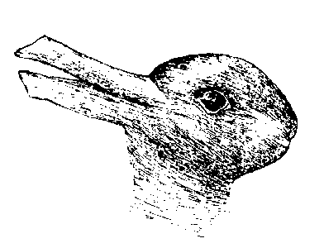
IT Asset Management introduction
ITAM perspectives
What do you see?

Slide 18
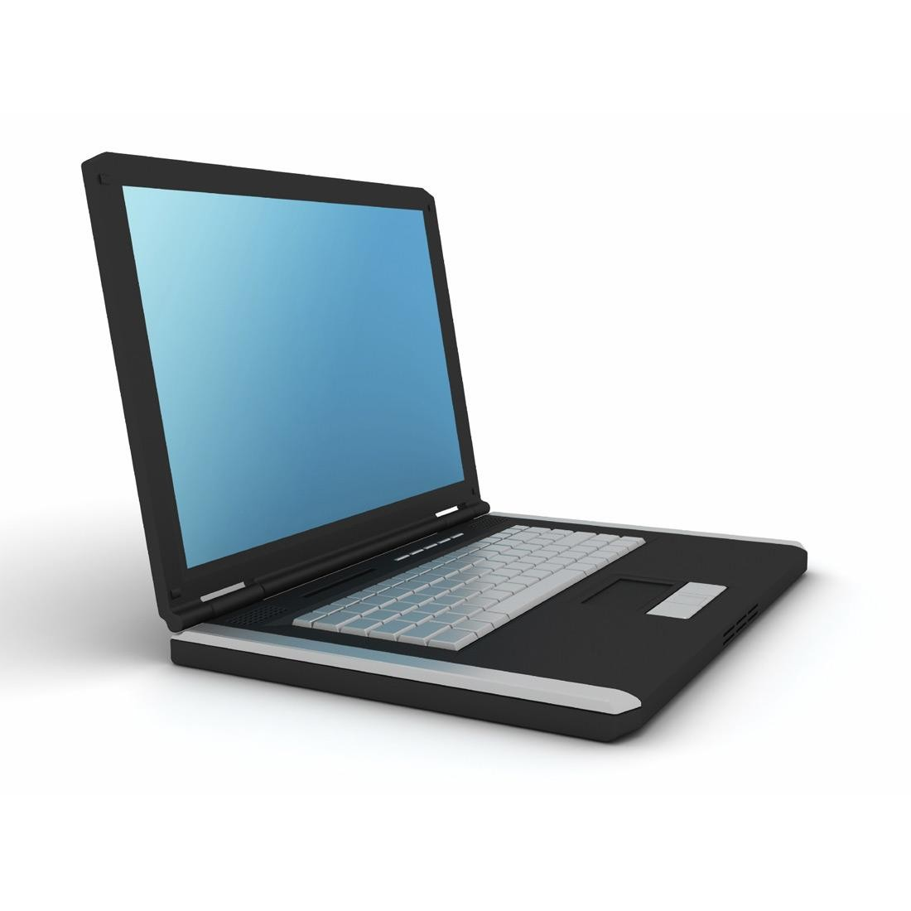
IT Asset Management introduction
ITAM perspectives
What do you see?

Slide 19



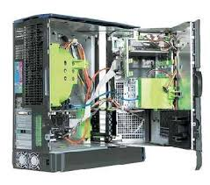




IT Asset Management introduction
ITAM perspectives
Examples of associations to “Computer”
A financial asset
Network
Hardware
A working tool
Software
An object to repair/maintain
Licenses, contracts and compliance

Slide 20
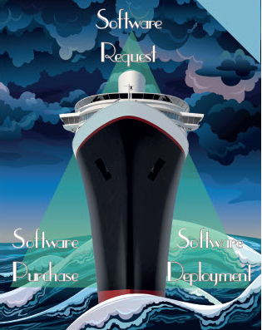
IT Asset Management introduction
ITAM Scorecard model
    Bermuda Triangle of ITAM
    Request
Purchasing
Deployment

Slide 21
ISO standards
and IT Service Management best practices

Slide 22
General concept
Best practice - IT Asset Management – ISO55000
ISO 55000
ISO 55000 is the first set of International Standards for Asset Management.
Enables an organisation to achieve its objectives through an efficient, consistent and sustainable management of its assets.
Provides an overview of asset management, its principles and terminology, and the expected benefits from adopting asset management.

Slide 23
General concept
Requirements in managing assets
Corporate
organisation management
Manage Asset Portfolio
Manage Asset System
Manage Assets
Organisational strategic goals & stakeholder expectations
Business management
Investment planning, return on capital employed, risk & sustainability
CIO, CFO, CTO
System performance
IT asset Manager
Create / acquire
Utilise
Maintain
Renew / Dispose of
Optimise life cycle activities
IT operation

Slide 24
General concept
ITAM system
Organisation strategic plan
Asset Management Policy
Asset Management objectives & Strategies
Development plan for management system
Asset Management plans
Asset Management capabilities
(Processes, resources, competencies & technologies
Continual improvement
Continual improvement
Lifecycle activities
Portfolio
Acquire / Create
Utilise
Asset System
Maintain
Assets
Dispose of / Replace

Slide 25
General concept
Best practice – ISO19770
ISO19770 purpose
IEC 19770 family of standards for IT asset management (ITAM) address both the processes and technology for managing software assets and related IT assets. Broadly speaking, the standard family belongs to the set of (or SAM) standards and is integrated with other Management System Standards.

Slide 26
General concept
Service Management best practice
Service Management best practice e.g. ITIL (formally known as Information Technology Infrastructure Library):
The most widely accepted approach to IT service management in the world.
Provides a cohesive set of best practices, drawn from the public and private sectors internationally.
Aligns IT services with the needs of business through a set of practices each covering an area of the service management lifecycle.
Allows the organisation to establish a baseline from which it can plan, implement and measure.

Slide 27
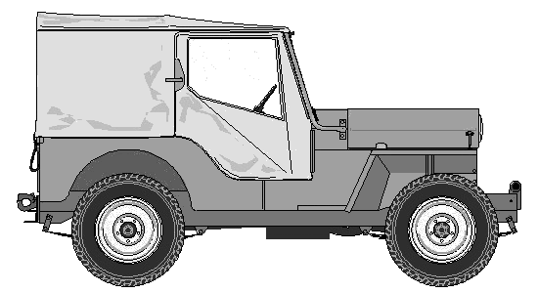
General concept
ITAM best practices
The interaction between Asset Management and Service Management can be regarded as a car with its components and the engine to run these:
Asset Management is the construction of all the components being a part of the asset lifecycle from planning and purchase to disposal.
Service Management is the engine enabling the Asset Lifecycle to run throughout the lifecycle by control of the assets.

Slide 28
ITAM models
.
Notes:
28

Slide 29

ITAM models
ITAM best practices
IT Service Management Best Practice
ISO55000
ISO19770
ITAM Best Practices

Slide 30
ITAM Models
ITAMOrg Best Practice
SOP = Standard Operating procedures TFP = Tier Framework processes TF = Tier Processes

Slide 31
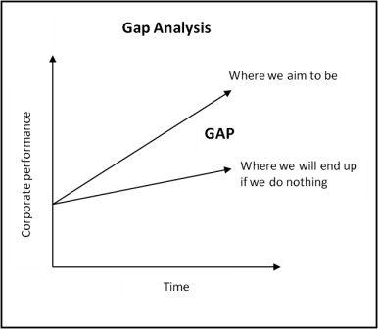
ITAM Models
GAP analysis
    The Gap analysis should be applied before implementing the ITIL/ISO best practices – as a compass pointing the direction to go.

Slide 32


ITAM Models
GAP analysis
The GAP analysis /assessment ‘in a nutshell’
Where do we want to be and why? Objectives
What do we need to get there?
Processes and activities

Slide 33


Tier 1 journey
Tier core processes
The process after the GAP analysis
Involve the key roles and ensure commitment
Go there and evaluate during the process

Slide 34
Quiz 1
What do you remember
What are the areas of IT Asset Management?
    SAM, HAM, SEAM, PIAM
  2. Why do we implement ITAM?
    Protect the value of IT assets, effective management, resource optimisation, risk mitigation, etc.
  3. Which departments are typically involved in ITAM?
    Management, Legal, Finance, Procurement, End-users, IT operation
  4. Which standards and best practices define processes for ITAM?
    ISO19770, ISO55000, ITIL 4

Slide 35
Exam preparation
Course introduction
Question 1:
Which of the following is the key component for ITAM success?
A. Good understanding of goals, motivation and key drivers from different stakeholders.
B. Maintain a good relationship with publishers, vendors, customers, legal and finance.
C. Manage and control all levels of IT assets.
D. Manage stakeholder expectations

Slide 36
Exam preparation
Course introduction
Question 2:
ISO/IEC 19770 is a standard related to ITAM, what is its purpose?
A. It is a set of processes for SAM to assist in managing the risks and minimizing the costs of IT assets.
B. It is an international standard for People and Information management to optimize availability, integrity and security.
C. It is a set of Best Practices to reflect best practice guidance contained within the ITIL (Information Technology Infrastructure Library) framework.
D. It is a specification for an information security management system (ISMS) to minimize risks for the IT Infrastructure.

Slide 37
Exam preparation
Course introduction
Question 3:
Which of the following activities help to create required insights at the Asset Portfolio level for the CIO/CFO?
A. investment planning and risk & sustainability.
B. Optimization of the lifecycle and organizational strategic goals
C. System performance and process control.
D. Utilization of assets, maintenance and supplier performance information

Slide 38
Exam preparation
Course introduction
Question 4:
The ITAM process framework is a tiered framework combining standards and Best Practices. Which of the following belong to the tool section of the ITAM process framework?
A. investment planning and risk & sustainability.
B. Optimization of the lifecycle and organizational strategic goals
C. System performance and process control.
D. Utilization of assets, maintenance and supplier performance information

Slide 39
Exam preparation
Course introduction
Question 5:
Which of the following is an outcome of an ITAM GAP analysis?
A. A project plan for the implementation of SAM.
B. The KPIs to determine the success of SAM
C. Ensured commitment and confirmation of the key roles.
D. An overview of useful processes already in place.

Slide 41
IT Asset Management
Hardware
Unit 2
Notes:
41

Slide 42
Hardware Asset Management
Learning Objectives
  At the end of this module, you will be able to:
    Describe:
      The concept and purpose of Hardware Asset Management (HAM)
      The HAM lifecycle in an organisation
      Mobile device (asset) management aspect of HAM
      The benefits of Hardware Asset Management
      The best practices of Hardware Asset Management
      The tool reflections of Hardware Asset management
Notes:
42

Slide 43
Hardware Asset Management
The concept of Hardware Asset Management
Hardware is essential in an ITAM context as the core of the IT infrastructure
SAM - Software Asset Management
SEAM - Cloud and Services Asset Management
PINAM – People & Information Asset Management
ITAM- IT Asset Management
HAM - Hardware Asset Management

Slide 44
Hardware Asset Management
Introduction
Hardware Asset Management (HAM):
Management of the hardware asset portfolio from acquisition through retirement.
The objective is getting the most value from the hardware assets.
Enables the organisation in making business decisions based on meaningful and measurable financial objectives.
Notes:
44

Slide 45
Hardware Asset Management
Introduction
Benefits of Hardware Asset Management (HAM):
IT Management
    Enabling Knowledge based business decisions with respect to procurement, replacement, disposal and re-use of an asset.
IT Operation
    Agility – short response time; Support the Business
    Re-use of hardware
    Use of standard HW services
Contract and Procurement Management
    Request standard services
    Easier negotiation – standard HW services
Financial Management
    Cost savings – reduction of over-disposal and over-procurement
    Compliance foundation data
Business
    Minimise risk of information security, software compliance and data loss
Notes:
45

Slide 46
Hardware Asset Management introduction
The Hardware lifecycle
    Hardware Assets lifecycle
Reuse or Recycle
Strategy & governance
Receive & Asset tagging
Request & Catalogue management
Procurement & Vendor Management

Slide 47
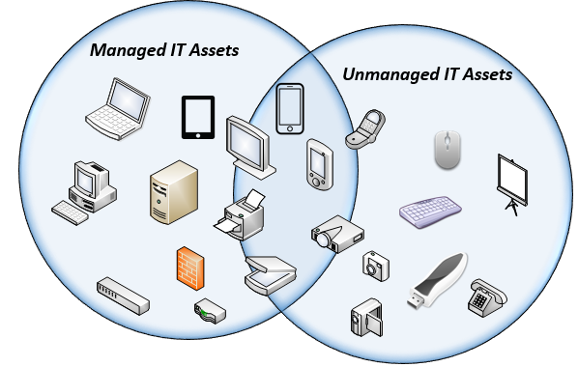
Hardware Asset Management
Identify your assets
Hardware refers to the physical components that make up a computer system… but when is an IT Asset not an IT Asset?
Notes:
47

Slide 48

Hardware Asset Management
Hardware Scope
Do IT HW assets require a pulse?

Slide 49
Hardware Asset Management
When to manage Hardware
Guidelines to determine if you need to track and manage an IT hardware Asset:
IT Asset tied to a contract
    This includes e.g. Servers, desktops, laptops and printers tied to lease agreements or service agreements.
Assets of great value (expensive)
Bringing value to the business because of the content (Licenses, Data etc.)
Notes:
49

Slide 50
Hardware Asset Management
Value of Hardware Asset information
Having identified your IT assets, you will need to consistently manage them throughout their entire Lifecycle in order to know:
When and from whom was the asset acquired?
Is it leased or owned by the company?
What are the costs associated with each asset during its lifecycle?
Who uses the asset?
How is it used?
When has it been deployed?
Where is it physically located?
When was it retired and disposed of?
Quiz! Who needs this information?
Notes:
50

Slide 51





Hardware Asset Management
Hardware Asset Management stakeholders
Hardware administrator
Procurement Manager
SERVICE DESK
Hardware Asset Management
Software manager
Contract manager

Slide 52
Hardware Asset Management
Hardware standards
One of the main objectives for a Hardware Asset Manager is to
Create Hardware Standards and maintain those standards
A standard could be
            Laptop standard
            Mobile device standard
            Desktop standard
            Printer standard
            Server standard
            Etc.

Slide 53
Hardware Asset Management
Thoughts about hardware standards
Several considerations influence when to use standards that are maintainable and cover the business needs
Cost per Asset type – low cost assets will probably not be maintainable
Volume of assets in the organisation – One plotter vs. 1000 Laptops
Asset Lifecycle and depreciation
Security risk
Legal requirements
Asset impact on the productivity
Asset redeployment
Mobility
Business needs per Asset Type
Internal IT Needs per Asset Type
What to put in the Internal and external Service Catalogue

Slide 54

Hardware Asset Management
Hardware tracking
How to track hardware ?
Network Scanning
RFID scanning
Tagging Barcode
Manual registration
Notes:
54

Slide 55
Hardware Asset Management
Tool reflections
The tool reflections of Hardware asset management
Historically, HAM has been the ‘entry level’ into ITAM for many corporations. This is primarily due to the fact that HAM is tool centric.
The HAM tool market is quite mature, since a tool will deliver more or less all of the information needed in good HAM.
HAM tool considerations, should actually be ITAM tool considerations.
Notes:
55

Slide 56
Hardware Asset Management
Hardware inventory
Hardware Inventory
When using a database you can collect the following hardware information from monitored servers and workstations and view them through the reports/inventory tool:
CPU Type, CPU Speed, CPU Count, Physical vs. Logical count
Installed Physical Memory,
Operating System, edition and service pack
UAC Level
Information about extended OS properties including 64-bit, Terminal Server, Server-Core, Hyper-V
Virtual machine detection, incl. virtual machine platform if available
Computer manufacturer and computer model, chassis type (if available)
BIOS Version, Serial Number (e.g. Service Tag)
Registered owner, registered company
Notes:
56

Slide 57
Hardware Asset Management
Hardware Asset Management Lifecycle
Audit
Reconcile
Control

Slide 58
Hardware Asset Management
Hardware decommissioning
There are two views into this area:
Decommissioning: Shutdown and remove the system or software
Disposal: Eliminate the software or hardware
Hardware decommissioning is an important activity for the Hardware Asset Manager. If it is not done properly this can cause several security risks, which can challenge the organisation.
There is one main regulation to take into account
“The organisation that bought the equipment is also responsible for the correct disposal”

Slide 59
Hardware Asset Management
Objectives
The objectives for Decommissioning are to:
Protect intellectual property
Ensure Software compliance
Separate electronics in accordance with policies and government regulations
      IT Assets are disposed legally and securely
      Disposal requirements are identified
      Disposed IT Assets can be tracked
      The end of life process and disposal processes are implemented as part of IT Asset Lifecycle process
      Information security for disposed IT Assets is ensured
Minimise risk when IT Assets are decommissioning and it is done cost effectively
Support and adapt green strategies

Slide 60
Hardware Asset Management
Decommissioning legalisation rules
The hardware Asset Manager should know the legalisation rules to follow when hardware is decommissioned or disposed.
    WEEE (Waste electronics and electronic equipment regulations (EU)
    RoHS (Hazardous Substances in Manufactured Equipment (EU)
    Basel convention on the control of trans-boundary movements of hazardous waste and Disposal (UN)
    RCRA (Resource conservation and recovery act (US)
There are some certificates that could help to recognise vendors that have implemented and follow mature decommissioning and disposal processes
    R2 – Responsible Recycling certificate
    E-stewards – Certificate developed by BASEL action network (BAN)
    RIOS – Recycling Industry operating standards
ISO14001 – Standard for environmental management and this includes R2 and e-steward

Slide 61
Hardware Asset Management
Hardware Leasing benefits
Hardware leasing benefits are:
Get the latest technology faster
Large capital expenses avoided, monthly payments
Minimise risk by disposal
There are two leasing alternatives
Operational leasing
Financial leasing

Slide 62
Hardware Asset Management
Leasing financial terms
The financial terms for leasing of hardware will typically include
Total payment per asset in the Hardware Asset contractual lifecycle
Maintenance
Warranty
Insurance
Data wiping
Return cost – Labelling and freight

Slide 63
Hardware Asset Management
Mobile Hardware
Mobile Device (Asset) Management aspect of HAM
A mobile devices is just another term for a computer. With the angle that it is often heavily used privately by the end-user.
What about BYOD (Bring Your Own Device)?:
- Since BYOD’s are not corporately managed, these devices and their ‘control’ belongs in the ‘People and Information Asset Management’ category. This area will be addressed on day two.
Notes:
63

Slide 64
Quiz 2
What do you remeber?
What are the stages of Hardware Asset Management Lifecycle?
    Plan, Acquire, Manage, Control, Retire
  2. Which regulation you need to beware in case of HW Asset disposal?
    WEEE (Waste electronics and electronic equipment regulations (EU) , RoHS (Hazardous Substances in Manufactured Equipment (EU), Basel convention on the control of trans-boundary movements of hazardous waste and Disposal (UN), RCRA (Resource conservation and recovery act (US), ISO 14001 etc.
  3. How can proper HW disposal contribute to the IT security?
    Proper deletion of data

Slide 65
Exam preparation
Hardware Asset Management
Question 1:
What does the Hardware Asset Manager need to deliver to the Software Asset Manager?
A. Documentation for relevant processes and procedures
B. Lists of assets including MAC addresses and IP addresses
C. Trustworthy and reliable data.
D. up-to-date data with valid sources

Slide 66
Exam preparation
Hardware Asset Management
Question 2:
What is one of the first decisions an organization needs to take in Hardware Asset Management?
A. The methodology for the management of all IT assets
B. The procurement process details for all IT assets
C. The security levels to be implemented on IT assets.
D. The IT asset types that need to be managed

Slide 67
Exam preparation
Hardware Asset Management
Question 3:
What are the phases of the HAM Lifecycle?
A. Initiation, Design, Build, Migration, Transition, Closing
B. Requirements, Design, Implementation, Verification, Maintenance
C. Strategy, Design, Transition, Operations, Continual Service Improvement
D. Strategy, Request, Procure, Receive, Manage, Retire

Slide 68
Exam preparation
Hardware Asset Management
Question 4:
Which type of IT assets should NOT be tracked and managed?
A. Assets like laptops or printers that are tied to a contract.
B. Assets that are very expensive
C. Assets that bring specific value to the business because of its content.
D. Assets that do not belong to the organization.

Slide 69
Exam preparation
Hardware Asset Management
Question 5:
What is the benefit of Hardware Standardization?
A. It enables all employees to work simultaneously
B. It secures an optimal purchasing price.
C. It simplifies the work of the HAM Manager.
D. It supports optimal service management processes.

Slide 71
IT Asset Management
Software
Unit 3
Notes:
71

Slide 72
Software Asset Management
Learning Objectives
  At the end of this module, you will be able to:
    Describe:
      The concept and purpose of Software Asset Management
      The placement of SAM in the ITAM eco system
      The business value of Software Asset Management
      The concept of compliance
      The risks/costs related to software audits
      The best practices of Software Asset Management
      The approach to achieving ‘good SAM’
Notes:
72

Slide 73
Software Asset Management
The concept of Software Asset Management
In a successful ITAM program, all key areas need to be taken into account. This module addresses Software Asset Management
SAM - Software Asset Management
SEAM - Cloud and Services Asset Management
PINAM – People & Information Asset Management
ITAM - IT Asset Management
HAM - Hardware Asset Management

Slide 74
Software Asset Management
What is Software
Software may be purchased (Licensed) or developed.
Software is characterised by a licensed position typically viewed as a CAPEX expenditure (i.e. given a written off value at the point of purchase). Although new models of deployment (e.g. SaaS) could see this revised as an OPEX expenditure.
People
Information
Software
Hardware
Notes:
74

Slide 75
Software Asset Management
The concept of Software Asset Management
Software Asset Management (SAM):
Has the objective of optimising the complete lifecycle of every software component, involving risk reduction and cost control
Is regarded as the most crucial ITAM area, representing the greatest financial and legal risk in relation to vendor license conditions and complex compliance regulations such as license compliance, entitlement compliance, country specific compliance regulations etc.
Notes:
75

Slide 76
Software Asset Management
Software Asset Management lifecycle
    Software Asset lifecycle

Slide 77
Software Asset Management
Benefits
The potential benefits of well implemented SAM are significant and have the potential to exceed the implementation and operating costs.
Benefits can be categorized as:
Managing risks
Cost control and savings
Obtaining competitive advantage
Enhancing employee motivation and the workplace environment
An improved software portfolio supporting the overall business drivers
Proactive planning and quality decision making

Slide 78
Software Asset Management
Challenges and pitfalls in SAM
Stakeholder co-operation in a successful SAM program
HAM: HW data Compliance
Contract/Legal: Terms & Conditions Agility
Procurement: Procurement data Compliance, software delivery duration
Management: Policies, rules of conduct Support, workflow and clear responsibilities
SAM REPORT & DOCUMENTATION

Slide 79
Compliance

Slide 80
Software Asset Management
Definition Compliance
Software compliance includes:
Licensing compliance: Ensuring that the use of all software within the organisation remains within all legal and contractual terms.
Security compliance: Ensuring that software policies are consistent with security policies and plans.
Policy and procedure compliance: Ensuring that SAM policies are consistent with corporate policies, strategies and plans.

Slide 81
Software Assets Management
Definition – Software Licenses
Software Licenses are rights to use software with certain terms and conditions attached.
The rights to use software are totally separate from the legal rights to the software itself. This is normally kept by the software manufacturer or other third party
Licenses may be bought or may be ‘free’ subject to special terms and conditions
Even ‘open’ source software normally has a license even though payment may not be required

Slide 82
Software Asset Management
In-compliance causes
Violations of license terms may be unintentional or intentional. They are often related to:
Software being used without licenses being purchased
Lack of understanding of licensing terms and conditions
Lack of records about software usage and often not even the number of PCs in use
Purchase from or installation by suppliers of unlicensed or counterfeit software
Lack of proof of license/ inaccurate documentation
Incorrect reliance on resellers
Pirated software

Slide 83
Software Asset Management
Compliance Myths
Myths about SAM
“Software Asset Management will cost me money, I will ignore it”
”It is cheaper to pay the fine if I am audited.”
”If I pretend that I don’t know what it is, I wont have to worry about it.”
”I want to decide what software need for my department. If we have centralised software Asset Management, I'll lose control.”
”We buy from a reseller. They ensure we are compliant, so I don’t have to do this.”
”If it was really important, we would have focus on it and knew what to do, but we haven't”

Slide 84
Software Audits

Slide 85
General concept
Definition Software audit
The definition of a Software Audit is:
A review of Software Assets conducted either internally or by an external compliance agency or software publisher in order to confirm compliance to copyright.

Slide 86
Software Asset Management
Consequence of a violation or Audit
The consequence of a violation or an audit could be
Reputational damage
Security violation
Down time
Delivery up
Fines
Imprisonment…?

Slide 87
Software Asset Management
Software audits
Stat. - Unlicensed software use per region
Source B | BSA survey report 2018
Notes:
An increasing number of enterprises are audited by software suppliers each year. The result of the survey reflects the evolution of use of unlicensed software worldwide per region

Slide 88
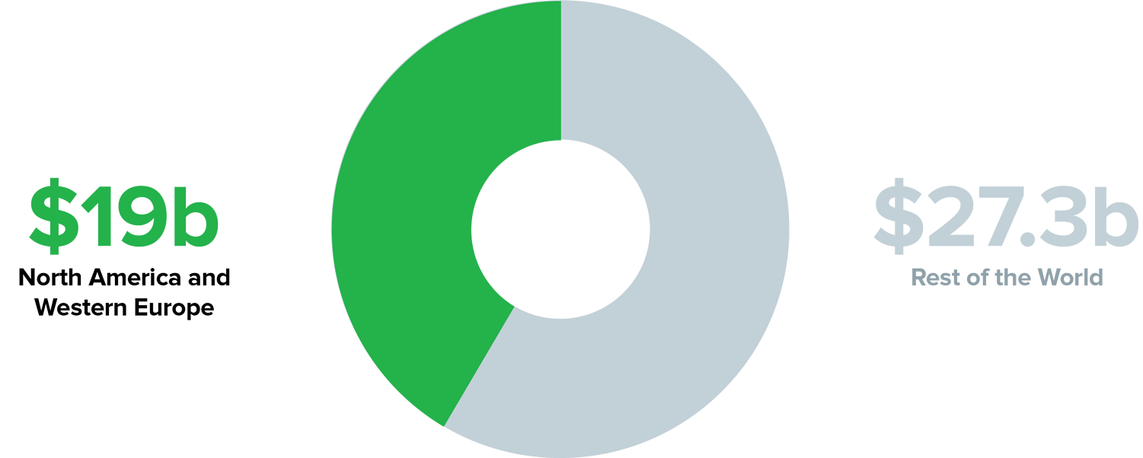
Software Asset Management
Value of Unlicensed software
Source B | Revulytics Software Piracy Stat Watch
Notes:
Data from the BSA Global Software Survey 2018 shows significant revenue generation opportunities in regions with strong intellectual property (IP) laws.
The survey shows the reason for why the Software publisher have focus on Audit. In 2017 the estimated value of unlicensed software is $46.302 Billion.
Enterprises that have been through a software license audit know what a blessing it can be to have a solid Software Asset Management program.

Slide 89
Software Asset Management
Case story
IBM Beats Suit Alleging IRS Was Duped Into Signing Software Deal
IBM defeated a whistleblower’s false claims suit in D.C. federal court accusing the company of fraudulently inducing the Internal Revenue Service into signing a $265 million software contract.
IBM worked with Deloitte LLP to create a false audit in an attempt to coerce the IRS into paying for unwanted software
IBM, with Deloitte’s assistance, fabricated audit findings concerning the agency’s software usage, and then presented those false findings to the agency to coerce the agency into agreeing to the contract.
The IRS agreed to the deal under the threat of a $91 million license charge penalty
Source: Blomberg Law
Article: https://news.bloomberglaw.com/federal-contracting/ibm-beats-suit-alleging-irs-was-duped-into-signing-software-deal

Slide 90
Software Asset Management
Case story
The High Court in London has ruled in favor of SAP and against Diageo in an indirect licensing case concerning the use of mySAP enterprise resource planning (ERP) software on a Salesforce platform
the drinks company and SAP had begun their software license and maintenance agreement in 2004, and came into dispute after Diageo deployed two new third-party systems in 2012.
SAP maintained that Diageo’s customer IT platforms, though based on Salesforce technology, connected back into mySAP ERP software and, accordingly, all Diageo’s ultimate customers (5,800 individuals) needed to be licensed as “named users”.
SAP brought its claim against Diageo in October 2015, seeking £54,503,578 in license fees, in addition to £3,955,954 in interest, fees for back support and maintenance, and an injunction.
The court reject Diageo’s submission that SAP PI is a ‘gatekeeper’ license for gaining access to the SAP suite of applications and database.
Only named users are authorized to use or access the mySAP ERP software directly or indirectly.
High Court rules for SAP, against Diageo in indirect licensing case
Source: Computerworld Weekly
Article: https://www.computerweekly.com/news/450413224/High-Court-rules-for-SAP-against-Diageo-in-indirect-licensing-case

Slide 91
Software Asset Management Processes

Slide 92
Software Asset Management
The stakeholders in the ECO system
ITAM (and SAM)
ECO system
Society, control and legislation
Customers
Corporate
Management
Partners
Corporate governance
Finance
End-users
Vendors/
resellers
Purchase
Legal
Distributors
Publishers
IT department/service

Slide 93
Software Asset Management
Roles and responsibilities
A successful SAM programme traverses the organisation and requires:
Clearly defined and agreed roles and responsibilities to ensure widespread adoption
Approval for the SAM strategy and vision and objectives from senior management

Slide 94
Software Asset Management
Principles - Software Asset Management
Development of a vision and strategy for SAM
Development and communication of an overall SAM policy
Regular review and improvement
Development and implementation of SAM processes and procedures
Continual improvement of SAM processes with concurrent maintenance of information
The SAM database

Slide 95
Software Asset Management
Activities
    Kick starting your SAM program begins here :
Gain approval for a SAM program from as high up the organisation as possible
Have documented goals and objectives
Ensure that all personnel are fully aware of what is expected of them
Understand how you are going to capture inventory data, and what is involved in comparing that to licensing data
Tool Selection: Ensure your organisation fully understand the business requirements that shape the criteria you use to select the software to support your SAM program
Consider what documentation is needed to manage the lifecycle of software through your organisation, and the interaction of those policies and procedures with your SAM program
Benchmark your existing operations so that you can build on the good work already in place

Slide 96
Software Asset Management
ITAM best practices
IT Service Management Best Practice
ISO55000
ISO19770
ITAM Best Practices

Slide 97
Processes and practically
SAM process areas by process type
IT Asset Functional Management Process Areas
Manage-ment of Change
Core Data Manage-ment
License
Manage-ment
Security
Manage-ment
Relation-ship and Contract Manage-ment
Financial Manage-ment
Service Level Manage-ment
Other Risk Manage-ment
1
1
1
1
3
3
3
3
IT Asset Life Cycle Management Processes
Specifi-cation
Acquisi-tion
Development
Release
Deployment
Opera-tion
Retire-ment
2
2
2
2
2
2
2

Slide 98
Software Asset Management
Implementation approach
Approach to implementing SAM in practice
IT Asset Functional Management process areas
Tier 1
processes
Tier 2
processes
Tier 3
processes
IT Asset lifecycle management processes
Tier 1: Trustworthy Data. Achieving this tier means knowing what you have so that you can manage it. This includes having reasonable assurance about license compliance.
Tier 2: Life Cycle Integration. Achieving this tier means greater efficiency and cost-effectiveness throughout the IT asset life cycle.
Tier 3: Optimization. Achieving this tier means greater efficiency and effectiveness through focus on cross-cutting functional management process areas.

Slide 99
Software Asset Management
Potential problems with Software Asset Management
Potential SAM problems:
Conflict with a decentralised culture
Lack of commitment by senior management
Lack of clear responsibility
Imbalance between customised and off-the-shelf software perspective
Underestimating the effort required to identify installed software
Legal requirements
Software license variation
Lack of communication
Inability to utilise existing SAM tools

Slide 100
Quiz 3
What do you remeber?
Why is SAM regarded as the most crucial area of ITAM?
    greatest financial and legal risk in relation to vendor license conditions and complex compliance regulations such as license compliance, entitlement compliance, country specific regulations etc.
  2. What is the definition of Software audit?
    A review of Software Assets conducted either internally or by an external compliance agency or software publisher in order to confirm compliance to copyright.
  3. What are the 3 Tiers of SAM practice implementation?
    Trustworthy data, Lifecycle integration, Optimisation.

Slide 101
Exam preparation
Software Asset Management
Question 1:
Which of the following is a valid attribute of a software asset?
A. distribution method
B. infrastructure utilization
C. purchase terms and currency
D. terms and conditions of software

Slide 102
Exam preparation
Software Asset Management
Question 2:
What is the purpose of Software Asset management?
A. To prevent personnel of using shadow IT to achieve their business needs.
B. To achieve risk reduction, compliance and cost control.
C. To be able to demonstrate that software is legally obtained.
D. To enhance capacity and availability planning for strategic forecasting.

Slide 103
Exam preparation
Software Asset Management
Question 3:
What creates a challenge for the IT Asset Manager when software needs upgrading?
A. inadequate hardware specifications
B. rigid installation processes
C. risk of loss of proof of purchase
D. uneducated end-users

Slide 104
Exam preparation
Software Asset Management
Question 4:
What is one of the most important reasons to invest in a good SAM solution?
A. It guarantees that no software penalties will be imposed.
B. It helps achieving a good overview of the software in the company which leads to optimization of the IT Infrastructure.
C. It reduces legal and financial risk for the organization and its responsible management.
D. It makes efficient use of licenses and effectuates a well-balanced portfolio.

Slide 105
Exam preparation
Software Asset Management
Question 5:
What is the purpose of an external software audit?
A. To check if the correct versions of the software are in use, so that support and maintenance are in alignment with the contract.
B. To confirm compliance to copyright and contract to make sure the software is used correctly, and the licenses are paid.
C. To make sure the software is used in compliance with the security policies of the organization.
D. To optimize the balance between software in use and the available licenses, so that software is used efficiently.

Slide 107
IT Asset Management
Services and Cloud
Unit 4
Notes:
107

Slide 108
Service and Cloud Asset Management
Learning Objectives
  At the end of this module, you will be able to:
    Describe:
      The concept and benefits of Services and Cloud
      What are the asset to manage within Services and Cloud?
      The concept of Services and Cloud Asset Management (SEAM)
      The benefits from SEAM
      The pitfalls in SEAM
      SEAM processes
      The placement of SEAM in the ITAM eco system
      Compliance in a Cloud perspective
      ITAM best processes in a Cloud perspective
Notes:
108

Slide 109
Service and Cloud Asset Management
The concept of Services and Cloud Asset Management
In a successful ITAM program, all key areas need to be taken into account. This module addresses Services and Cloud Asset Management (SEAM)
SAM - Software Asset Management
SEAM – Services and Cloud Asset Management
PINAM – People & Information Asset Management
ITAM- IT Asset Management
HAM - Hardware Asset Management

Slide 110
Services and Cloud
Definition

Slide 111
Services and Cloud Asset Management
Services and Cloud - Definition
    Services and Cloud
    Refers to services delivered from a provider’s servers via the internet.
    Can be categorised as “out-of-house” services opposed to services from the company’s own servers (“in-house”).
    Includes e.g. data storage capacity, backup solutions, web-based services, hosted applications or database processing, etc.

Slide 112
Services and Cloud Asset Management
Services and Cloud - concept
Services and Cloud can be seen as an out-of-house appendix to the hardware and software in-house.
The business requires direct services such as IT Hotline, user training and company aligned policies.
The IT organisation delivers services to the known IT operation and support of the usability of the end-user.
“Services and Cloud” are just another word for outsourcing!
- You purchase services in order to enhance the business value of the company
Notes:
112

Slide 113
Services and Cloud Asset Management
Services and Cloud - types
    Services and Cloud can be categorised in 3 models:
    IaaS – Infra-structure as a service
    PaaS – Platform as a service
    SaaS – Software as a service

Slide 114
Services and Cloud Asset Management
Services and Cloud - Benefits
    Organisational benefits from Services and Cloud:
  Enables focus on the core business
  Access to complex it systems without the costs in buying and managing the underlying software and hardware
  Required system performances and at the same time lower operational costs
  Scalability of server requirements, the set-up can be adjusted immediately when the needs of the organisation change
  Agility, access to systems and data from various locations, platform and devices + flexible and agile solution set-up enabling quick service changes

Slide 115
Services and Cloud Asset Management
Services and Cloud – pitfalls and risks
Pitfalls in Cloud and services
Standard solution not adjusted the specific needs of the organisation
Complex compliance positions
Loss of control and lack of transparency
Changes in well-known existing IT interface and functionality, impact on productivity and workflow, etc.
Service provider may change your services beyond your request

Slide 116
Services and Cloud Asset Management
Services and Cloud - Assets
    The following ASSETS have to be managed in a Services and Cloud solution:
    Internal System performances and services
    Data integration, usability
    Measurements (SLA’s)
    Contract
    Contract
    And…contract….

Slide 117
Services and Cloud
Asset Management
Concept

Slide 118
Cloud and Services Asset Management
The concept of SEAM
Services and Cloud Asset Management (SEAM):
      Has the objective of optimising and documenting the complete lifecycle of every cloud and service component, including the contractual terms, deliverance and service components with focus on risk reduction and cost control.
Notes:
118

Slide 119
Services and Cloud Asset Management
The concept of SEAM
Organisations need to approach a triple play of computing environments
IT infrastructure
User interface
End-user
Business requirements
Knowledge sharing
Data and information
Production
Physical
servers
Virtual
servers
Cloud
operations

Slide 120
Cloud and Services Asset Management
The concept of SEAM
SEAM activities include:
Contract negotiations and definition of terms and SLA’s.
Measurements (SLA’s) of delivered services.
Ensuring that all legal regulations are followed, including license and compliance terms.
Alignment of the services and the organisational needs in terms of storage, data protection, system capability, policies and availability
    These processes typically requires a SEAM manager involved in budget planning, strategy planning an contract negotiation in order to ensure alignment throughout the organisation.
Notes:
120

Slide 121
Services and Cloud Asset Management
Benefits of SEAM
Benefits of Services and Cloud Asset Management (SEAM) Managing risks
    Gaining control
    Ensuring a contract and solution that supports the long term planning in the business
    Lowering operational costs
    Avoiding unexpected costs due to tight contract terms.
    Compliance.(Software, Company policies, Legal)
    Increased performance in-house and out-of-house
    Ensuring that the out-of-house architecture enhances the workflow in the organisation

Slide 122
Services and Cloud
Asset Management
Processes

Slide 123
Services and Cloud Asset Management
Services and Cloud processes
Has Cloud become a BUZZ word??
68% of IT professionals say employees’ requests for cloud services have increased over the last two years.
(CDW’s State of the cloud report 2013)
Notes:
123

Slide 124
Services and Cloud Asset Management
Services and Cloud definition
The processes of SEAM consists of two parts:
Contract negotiations and signing
Based on a prior analysis of the organisation's needs in terms of :
system performances, storage, agility, scalability, user rights, data movements, usability, support, training, contract management regulations, etc.
The operational and practical level after contract signing
Definition of the activities and measuring points needed both externally and internally, ensuring that the contractual terms are achieved and the SLA’s met. Also that internal compliance is ensured via ongoing processes.
Notes:
124

Slide 125
Services and Cloud Asset Management
Processes before negotiating
    Pre-analysis before negotiating:
    In which areas does our company get added value by this service?
    What are the financial savings and costs in this solution?
    What risks are implied? How can we manage these?
    Regulations from society needed to be taken into account?
    Do we have the competencies to negotiate a long term contract?
    Do we have the resources to manage the contract and to ensure that the contract terms are followed and the SLA’s are met?
    How do we plan the change?
Notes:
125

Slide 126
Services and Cloud Asset Management
Processes before signing the contract
The SEAM manager needs to understand both the business and the Vendor
Internal challenges
Vendor advantages
People
balanced security
Human Competence
Measurable
service levels
External Specialist
Known challenges when using internal services organisation
Services and Cloud providers business advantage
IT Operations
in focus
Hardware dependencies
Time to
perform
Service specialist
IT Complexity of
many system
Service, primarily business focus
Technology innovation
Shared information across services
Understand the difference in the services and the request a contract is based on.
Notes:
126

Slide 127
Services and Cloud Asset Management
GAP analysis
    Gap Analysis: A tool in the pre-signing process
    What are our IT needs today and in the future? Performance, software, speed time, flexibility, user rights, inventory information, etc.
    How do we plan the journey/migration into cloud?
    How will it impact the users?
    What activities and resources do we need to get there?
    When migrated, which practices do we need to maintain the standards and objectives?

Slide 128
Services and Cloud Asset Management
Pitfalls - Contract terms
Contractual pitfalls 1/2:
Services agenda
    Clear SLA’s, data and server deliverance terms
    Undefined data ownership
    User rights and traceability
    Access from multiple platforms
  Agreement terms and condition
    Complex exit clauses - terms to exit the contract and how to get your data.
    Launch of payments - Payment starts upon rollout and not before!
    Pricing, a fixed price model, including support and access from different regions and platforms and meaningful regulations in e.g. price increases.
    Penalties: services breaches from the provider are tied to financial credits
    Inventory information, the provider should share all inventory data and have clear agreements
Notes:
128

Slide 129
Services and Cloud Asset Management
Pitfalls - Contract terms
Contractual pitfalls 2/2:
  Support
    End user support in native language
    2nd level complies with enterprise support time
    Training and EDU program
Notes:
129

Slide 130
Services and Cloud Asset Management
The operational and practical level after contract signing
    The operational best practices after contract signing:
    “One time” task
      Internal work flow - clear definition of roles and responsibilities working within the contract governance
    Routine task
      Monitoring of SLA’s: Service availability, both externally and internally
      Compliance management
      Ensuring data connections and a high level user interface
    Strategic task
      Ongoing attention to required adjustments in the service as the organisation’s needs change
    The approach relies upon the existing internal ITAM processes.

Slide 131
Services and Cloud Asset Management
The stakeholders in the ECO system
ITAM
ECO system
Society, control and legislation
Customers
Corporate
Management
Partners
Corporate governance
Finance
End-users
Vendors/
resellers
Purchase
Legal
Distributors
Publishers
IT department/service

Slide 132
Services and Cloud
Asset Management
Compliance

Slide 133
Services and Cloud Asset Management
Non-compliance causes – also in Services and Cloud
The violation of license terms, also relevant in Services and Cloud:
Software being used without licenses being purchased
Lack of understanding of licensing terms and conditions
Lack of records regarding software usage and often not even the number of PC’s in use
Lack of proof of license/ inaccurate documentation.
Incorrect reliance on resellers

Slide 134
Services and Cloud Asset management
ITAM in relation to the contract terms
ITAM processes in Services and Cloud solutions – be aware of:
    Do you also follow ISO 55000 and 19770 in the cloud?
      These processes and best practices are crucial in relation to Services and cloud. Your organisation is still responsible with respect to license terms. Therefore e.g. the inventory information is an important component in your cloud agreement.
Responsibility - compliance regulations:
      E.g. if (when) the license rules change, who is responsible for ensuring that the cloud set-up is compliant? The provider or you? Be clear in the contract!
Make sure you have an insurance agreement in the contract
      E.g. if your company is non-compliant due to a mismatch between the inventory information from the provider and the actual hardware and software in use.
God ide at få en IIT advokat til at forhandle
Referer til ISO 55000 og 197000 – kræv samme procedure ift leverandøren)
(senere: Ole lidt om hvordan man håndterer de mange platform. ET der udfordringer I den sammehøng?=
Notes:
134

Slide 135
Services and Cloud Asset Management
Implementation approach
SAM approach in practice in SEAM
IT Asset Functional Management process areas
IT Asset lifecycle management processes
Tier 1
processes
Tier 2
processes
Tier 3
processes
Tier 1: Trustworthy Data. Achieving this tier means knowing what you have so that you can manage it. This includes having reasonable assurance about license compliance.
Tier 2: Life Cycle Integration. Achieving this tier means greater efficiency and cost-effectiveness throughout the IT asset life cycle.
Tier 3: Optimization. Achieving this tier means greater efficiency and effectiveness through focus on cross-cutting functional management process areas.

Slide 136
Services and Cloud Asset Management
Best practices
Remember Tier 1 in SAMS? Make sure that these processes are implemented in relation to the services and cloud set-up
SAM Asset identification
Software Asset Inventory Management
SAM Asset Record Verification
Software Licensing Compliance
Conformance Verification for SAM

Slide 137
Quiz 4
What do you remeber?
What is so-called Triple play in ITAM?
    Physical servers, Virtual servers, Cloud operation
  2. What are the contractual pitfalls within SEAM?
    Services agenda (Clear SLA’s, delivery terms, data ownership, user rights, multiplatform….)
    Agreement terms and condition (exit clauses, how to get your data, payment term, pricing, service credits, inventory information… )
    Support
  3. What are the 2 parts of SEAM Processes?
    Contract negotiation and signing
    The operational and practical level after contract signing

Slide 138
Exam preparation
Services and Cloud Asset Management
Question 1:
What is the most important benefit of Cloud services?
A. shared hardware is always cheaper than dedicated solutions
B. easier safety procedures and simple connectivity
C. higher availability of the services
D. agility and scalability of the solution

Slide 139
Exam preparation
Services and Cloud Asset Management
Question 2:
What does a Platform as a Service (PaaS) include?
A. provider network, servers, storage, business applications
B. computers, virtual machines, Infrastructure, firewalls
C. provider network, servers, storage, tools
D. provider network, computer, virtual machines, firewalls

Slide 140
Exam preparation
Services and Cloud Asset Management
Question 3:
What are pitfalls of Cloud services?
A. Changing environment and lack of control.
B. Data safety cannot be provided, as it is unknown where data is stored.
C. Loss of control on compliance, version updates and influence.
D. Lower availability which cannot be upgraded.

Slide 141
Exam preparation
Services and Cloud Asset Management
Question 4:
What is the scope of asset management in SEAM?
A. Availability, capacity, continual service improvement and service design
B. Configuration management database, asset management and the component lifecycle control.
C. Contractual terms, delivery, service levels and service components
D. Licenses, hard and software maintenance, performance

Slide 142
Exam preparation
Services and Cloud Asset Management
Question 5:
Which of the following should be included in a pre-analysis before negotiation?
A. Contractual terms, regulations and financial savings
B. Cost realization, environment structure and support channels
C. Financial savings/costs, risks and resources to manage the contract
D. How to plan the change, environmental structure and operational optimizations

Slide 144
IT Asset Management
People & Information
Unit 5
Notes:
144

Slide 145
People and Information Asset Management
Learning Objectives
  At the end of this module, you will be able to:
    Describe:
      How to perceive People and Information as Assets
      The concept and purpose of People and Information Asset Management (PINAM)
      The benefits of People and Information Asset Management
      The pitfalls related to information leaks/mishandling
      Guiding principles of PINAM
      The placement of PINAM in the ITAM eco system
      How PINAM relates to HAM, SAM and SEAM
Notes:
145

Slide 146
People and Information Asset Management
Introduction
The areas Hardware, Software and Cloud have no value without employees and knowledge. This module addresses Management of People and Information in an ITAM perspective.
SAM - Software Asset Management
SEAM – Cloud and Services Asset Management
PINAM – People and Information Asset Management
ITAM - IT Asset Management
HAM - Hardware Asset Management

Slide 147
People and Information Asset Management
Definition

Slide 148

People and Information Asset Management
Introduction
Your content and your people are the core currency of your business.
People
Role / job title
Responsibility
Granted user rights

Slide 149
People and Information Asset Management
Concept
People
Information
Software
Hardware
Notes:
149

Slide 150




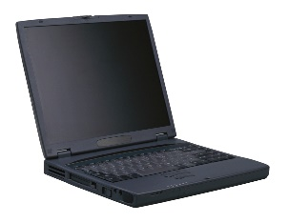
People and information Asset Management
Concept
Today’s most productive employees are not tied to a desk, an office, or a location.
People
Mobility
Flexibility
Data
Information
Access

Slide 151


People and Information Asset Management
Security risks
57% points to their own staff
Who or what do you see as the greatest security risk in your company?
Source: Ernst & Young, 2014: Survey among top leaders from 1.800 organisations in 60 different countries across all industries.

Slide 152
People and Information Asset Management
Data and Information
Support Activities
Company Infrastructure
Human Resource Management
Technology Development
Procurement
Communication and Social Media
Information
Data Layer
Inbound Logistics | Operations | Outbound Logistics | Marketing and Sales | Service
Primary Activities
Data Layer

Slide 153
People and Information Asset Management
Concept
The benefits and risks of information tools
At the same time as advanced IT tools offer great organisational benefits, they also involve risks in terms of data leaks, security failures, data sharing beyond the company’s interests, etc.
This requires a balancing between distribution/sharing and limiting/controlling of data and information, internally as well as externally.
Notes:
153

Slide 154
People and Information Asset Management
Concept
A key point in PINAM is the balance between information agility and information security
Notes:
154

Slide 155
People and Information Asset Management
Concept
People and Information Asset Management (PINAM):
Has the objective of managing the complete lifecycle of every valuable information component and the people around it. This involves optimal knowledge sharing and delivery of information to the right people at the right time, control of data security and user rights, data traceability, information transparency, policy setting and enforcement.
Notes:
155

Slide 156
People and Information Asset Management
Concept
SHARING
Available
Accessible
Visible
Agile
People and Information Asset Management
Comprehensive
Updated
Consistent
Valid
Integrity
Policies
User rights
Traceability
Alarm systems
Confidentiality
SECURITY
QUALITY
Structured
Targeted
Timely
Requirement-based
EFFICIENCY

Slide 157
People and Information Asset Management
Benefits
The potential benefits of well implemented People and Information Asset Management are:
Optimal information and knowledge sharing across desktop and mobile.
Enhanced company productivity and competiveness.
Organisational awareness of the value of corporate information and appropriate handling of this.
Data/information control, including mobile content.
Risk reduction.
Avoiding exposure of valuable company information.
Avoiding leaks/stopping leaks swiftly.

Slide 158
People and Information Asset Management
Guiding principles

Slide 159
People and Information Asset Management
Process
Guiding principles to achieve “good PINAM”:
Information assets are corporate assets.
Information must be available, to the right people at the right time.
Valuable information needs to be identified, managed and retained corporately.
All valuable information should be traceable.
Information Asset Management is a corporate responsibility that needs to be addressed across all functions and levels in an organisation.

Slide 160
People and Information Asset M management
Guiding Principles
3 PINAM principles to support productivity:
Access anywhere: Sharing and managing files from any device.
Rich platform for work: Ensuring the ability to interact with any relevant document through tasks, comments, rich preview and clear permissions.
Cohesive collaboration: Tightly integrated with everyone’s preferred mobile and desktop productivity tools.

Slide 161
People and Information Asset Management
Guiding Principles
…..but without sacrificing security, visibility and control
Security: Centralise content into a secure content platform that integrates identity, device and application management toolsets.
Visibility: Monitor, measure and report on content as it flows to mobile devices and across to customers, partners and vendors.
Control: Control device access, sanction productivity apps, and directly manage how everyone in your organisation accesses and uses information.

Slide 162
People and Information Asset Management
Processes

Slide 163
People and Information Asset Management
Processes
How do we manage “important information”?
Information categorisation
Content restrictions
Data tagging and user rights management
Data traceability
Policies
Notes:
163

Slide 164

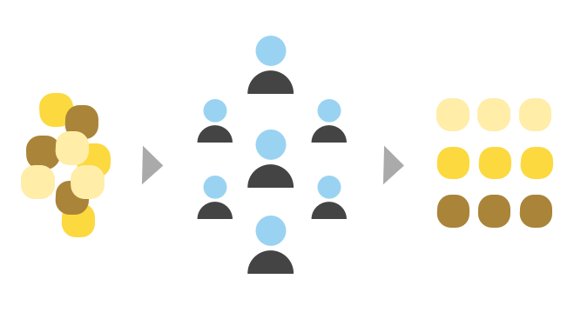
People and information Asset Management
Content Restrictions
The first step in PINAM is Information Categorisation and Content Restrictions
Definition of important information and categorisation
Who can access what kind of content? How, when and where?
Content
People and Knowledge

Slide 165
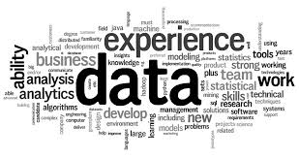

People and information Asset Management
Content Restrictions
Content restrictions can be linked to both users, data, folders and documents:
Restrictions:
Who can access?
Who can read, edit, etc.?
Allowed reading time?
Allowed copying and attaching?
Allowed forwarding?
Etc.

Slide 166
People and information Asset Management
Data tagging and user rights
The next step is data tagging, which can be addressed on two levels
Data tagging and management of user rights - Level 1:
Important information is categorised and saved in folders. People and groups are manually added to the relevant folders, while others cannot access the information.
As this process to some extent is driven manually, it requires clear policies and consistent procedures in order to avoid errors.

Slide 167
People and information Asset Management
Data tagging and user rights
Data tagging and management of user rights
Level 2:
Important information is tagged technologically and categorised.
A list of people and user rights is activated whenever a person tries to access any information.
These processes are ongoing ensuring security that is consistent and up-to-date.

Slide 168

People and information Asset Management
Data traceability
Data traceability
Traceability is facilitated by tagging: Who reads the important information? When? To whom is it shared?
Traceability also enables alarm systems, e.g., when large amounts of information is copied or shared, or if user patterns vary from normal.

Slide 169
People and Information Asset Management
Policies
PINAM Policies relate to:
Code of conduct in handling company information.
The level and complexity of password setting (on devices, systems, documents).
Use of USB sticks (e.g. only company owned and encrypted).
Use of computers, phones and tablets (e.g. company owned vs. BYOD, how to react if a device is gone etc.).
Use of private cloud/email services/whitelists of private services and cloud.

Slide 170
People and Information Asset Management
Policies
Policies rely on people and behaviour and require:
Clear corporate communication of the defined policies and their purpose throughout the organisation.
Appropriate Management conduct.
Persistent reminder processes surrounding the policies.
Education of the employees in following the policies.
Availability and service around devices and functionality.
Clear definition of roles and responsibilities to ensure that policies are respected and kept up to date.
Employee contracts reflecting the policies and code of conduct.
Clearly defined consequences of violating the policies.

Slide 171
People and Information Asset Manage
Technologies
Technologies supporting PINAM
Identity Management System (Proactive and preventive)
Ensures that usernames and definitions correlate with actual people.
Ensures that users only have access to the data they need to perform their jobs.
Role based Identity Management
Attribute based access control
Access control Systems (Proactive and preventive)
Enforces access on Operating systems, Databases and applications, usually built in.
Random attacks and viruses will normally not affect as many files if this is in place.

Slide 172
People and Information Asset Management
Technologies
Technologies supporting PINAM
Data Tagging System (Preventive and reactive)
Meta data assigned to a piece of information
Categorisation and classification of data
Ensures that you can manage access control, document restrictions, etc.
Enables analysis, e.g. in order to identify if a file contains confidential information
Firewall Discover Systems (Reactive and preventive)
Data content analysis and discovery.

Slide 173
People and Information Asset Management
Technologies
Technologies supporting PINAM (continued)
Event Management Systems (Reactive)
Monitor user activity on critical systems, relate the activity to the person.
Log management.
Behaviour analysis. i.e. alert, if someone exports customer details from CRM
Mobile and Device Management (MDM) (Reactive and preventive)
Ensures control of mobile devices, including encryption and locating and/or resetting device.

Slide 174
People and Information Management
ISO 27001
What is ISO 27001?
An information security framework of policies and procedures including all legal, physical and technical controls involved in an organisation’s information risk management.
.
Includes details for documentation, management responsibility, internal audits, continual improvement, and corrective and preventive action.
Enables organisations to manage the security of assets such as financial information, intellectual property, employee details etc.

Slide 175
People and Information Management
ISO 27001
ISO 27001 planning process
Define a security policy.
Define the scope of the Security Management system.
Conduct a risk assessment.
Manage identified risks.
Select control objectives and controls to be implemented.
Prepare a statement of applicability.
The standard requires cooperation across all sections of an organisation.

Slide 176
People and information Asset Management
The stakeholders in the ECO system
PINAM
ECO system
Society, control and legislation
Customers
Corporate
Management
Partners
Corporate governance
Finance
End-users
Vendors/
resellers
Purchase
Legal
Distributors
Publishers
IT department/service

Slide 177
People and Information Asset Management
Services & Cloud
BYOD

Slide 178
People and information Asset Management
PINAM principles in Services and Cloud
Loyalty to the PINAM Principles in Services and Cloud set-ups
Do not deviate from the overall guiding PINAM principles when signing a Services and Cloud agreement.
Also in the cloud, valuable information should be traceable, tagged and monitored.
Ensure security control and security guarantees.
Ensure that you have the rights to manage user rights and data restrictions continuously.
Define ownership of your content, e.g., in case of contract termination: Who owns the data? How and when will it be delivered?

Slide 179
People and information Asset Management
PINAM principles towards shadow IT
Shadow IT PINAM risks and principles
Shadow IT: End-users in the company using private file sharing solutions such as Dropbox. The solutions are not approved by the IT department, and therefore unmanaged, unmonitored and unsupported.
The data stored in these solution is put at risk of loss and exposure.
The use of shadow IT must be addressed by consistent policies defining whitelists of solutions and code of conduct around shadow IT.
The company must provide solutions delivering the functionalities that the end users demand.

Slide 180
People and information Asset Management
PINAM principles in BYOD
BYOD in a PINAM perspective
Definition - What does Bring Your Own Device (BYOD) mean?
Refers to employees who bring their own computing devices, such as smartphones, laptops and tablet PC’s, to work with them and use them in addition to or instead of company supplied devices.
If BYOD is supported in a company, a PINAM strategy should be implemented setting up policies and regulations such as:
“Cleaning” of mobile devices when employees leave the company
Mobile security (PIN requirements)
Responsible conduct
Which content can be accessed and shared from the devices?
How do you track and monitor these devices?
Security controls

Slide 181


People and Information Asset Management
PINAM principles in a Shadow IT and BYOD perspective
50% of the corporate IT users do not know the policies in the company concerning the use of shadow IT and BYOD
This indicates that a large number of companies do not have policies or do not communicate or enforce their policies consistently or educate their staff in following PINAM policies correctly.
*Source: Survey by Nasuni, 2012, among 1,300 corporate IT users.

Slide 182

People and Information Asset Management
Relation to ITAM areas
How does PINAM relate to HAM, SAM and SEAM?
Data / Information
Cloud
Sharing on
SaaS
People
Iaas
Access to
Software
Running on
Hardware
Access to
Running on
Data / Information

Slide 183
Quiz 5
What do you remeber?
How can ISO 27001 help organisation in relation to PINAM?
    Define a security policy, define the scope of the Security Management system, a risk assessment, risks management, setting controls to be implemented, prepare a statement of applicability, cooperation across all sections of an organisation
How does PINAM relate to other components of ITAM?
    People are accessing software, running on hardware, storing information to the cloud….
  2. What is the biggest risk of Shadow IT from PINAM perspective?
    information security, data stored in unmanaged, unmonitored and unsupported.

Slide 184
Exam preparation
People and Information Asset Management
Question 1:
What is one of the most important key objectives of People and Information Asset Management?
A. Control of the license structure in (cloud) identity management systems
B. Managing the user account synchronization in the hybrid environment
C. The balance between information agility and information security
D. The capacity management for the cloud-based document management systems

Slide 185
Exam preparation
People and Information Asset Management
Question 2:
What is an important direct benefit of People and Information Asset management?
A. It increases employee satisfaction by managing the employee lifecycle.
B. It provides Information control including mobile content and risk reduction
C. It provides better compliance and cost control for the organization
D. It helps achieving higher grip on the organization's procedures and processes by Internal auditing and control

Slide 186
Exam preparation
People and Information Asset Management
Question 3:
Which of the following is one of the important aspects of information categorization?
A. What information is defined as HR/Finance/IT/Procurement?
B. What information is directly accessible from all computers?
C. What information is important for the company?
D. What information is required by management?

Slide 187
Exam preparation
People and Information Asset Management
Question 4:
How can Shadow IT compromise the company’s integrity?
A. Shadow IT involves illegal software that causes non-compliance.
B. Shadow IT does not adhere to the company’s security procedures.
C. Shadow IT is not very stable and has a low availability causing lower productivity.
D. Shadow IT is not maintained by the company’s IT department and therefore not acceptable.

Slide 188
Exam preparation
People and Information Asset Management
Question 5:
What is the advantage of BYOD for a company?
A. It increases variety, so the organization can easily experience software on all platforms
B. It provides employees with the device of choice, which increases motivation and productivity
C. It saves the company time as they do not have to develop hardware standards
D. it saves the company money because these devices are bought by the employee

Slide 190
IT Asset Management
Interfaces
Unit 6
Notes:
190

Slide 191
IT Asset management interfaces
Learning Objectives
  At the end of this module, you will be able to:
    Describe:
      The stakeholder ECO-system
      Roles and responsibilities
      The relation between HAM, SAMS, SEAM and PINAM
      Communication between IT Asset Stakeholders
      The need for policies, procedures and technologies
Notes:
191

Slide 192
IT Asset management interfaces
Overview of ITAM modules
ITAM is about to protect the company IT assets wherever they are and support the protection of company intellectual property.
SAM - Software Asset Management
SEAM – Cloud and Services Asset Management
PINAM – People and Information Asset Management
ITAM - IT Asset Management
HAM - Hardware Asset Management

Slide 193
IT Asset Management interface
Approach
ISO19770 / 55000
Hardware
Alignment
Software
Transparency
Alignment
Alignment
IT Governance / ISO38500
IT Security /ISO27000
Cloud & Services
Alignment
People & Information
ITSM best practice /ISO20000
Notes:
193

Slide 194
IT Asset management interfaces
ISO55000 – IT Asset Management
Co-ordinate activities
Realise value from assets
Establish policies, objectives and processes
Managing organisation
Asset Management
Asset Management system
Asset Portfolio
Notes:
194

Slide 195
IT Asset Management interfaces
ISO55000 Value creation
Purpose of ISO55000 is to ensure value creation
Compliance, avoiding value destruction
Risk Management
Effectiveness and Efficiency
Value Innovation
Disruptive Change

Slide 196
IT Asset management Interfaces
ITAMOrg Alignment
ITAMOrg’s approach to IT Asset Management is
Objectives into actions
    GAP analysis
    Tiered approach
Integration
    Alignment of processes
    Alignment to Business processes
A supporting Asset Management System

Slide 197
IT Asset Management Interfaces
Leadership
Proper IT Asset Management needs leadership
Workplace culture
Roles, responsibilities and authority
Awareness
Stakeholder involvement

Slide 198
IT Asset Management interfaces
Assurance
IT Asset Management assurance
Assets fulfil purpose
Processes
Connection to organisational objectives
Continual improvement
Necessary resources

Slide 199
IT Asset Management interfaces
IT Asset Manager responsibility
IT Asset Manager job description include
Primary duties and responsibilities
    Implements processes, procedures and systems for tracking and analyzing software, hardware, and equipment from requisition through retirement.
    Manage all assets within the organization and affiliated companies.
    Manage acquisition of assets from planning through deployment.
    Report to senior management ITAM/life cycles and resolve conflicts.
Personal attributes
    Proven ability to translate business requirements into technical solutions.
    Strong analytical and problem-solving skills; resourceful and capable of working in the abstract, with the ability to understand multiple facets of complex technologies.

Slide 200
IT Asset Management Interfaces
ITAM process ECO system
IT Asset Management ECO system
IT Governance
Operational management/ control of supporting business processes through reliable deliveries
IT Service Management
Lifecycle
Lifecycle management of IT Assets
IT Asset Management
Lifecycle
software
Hardware
Services & Cloud
People & Information

Slide 201
IT Asset management interfaces
The stakeholders in the ECO system
ITAM
ECO system
Society, control and legislation
Customers
Corporate
Management
Partners
Corporate governance
Finance
End-users
Vendors/
resellers
Purchase
Legal
Distributors
Publishers
IT department/service
IT specialists
IT specialists
IT specialists
IT specialists

Slide 202
IT Asset Management interfaces
IT Governance
Is it possible to improve IT decision making with automated analysis of the full Asset lifecycle?
Compliance
Governance
!
!
IT Support
Risk exposure

Slide 203
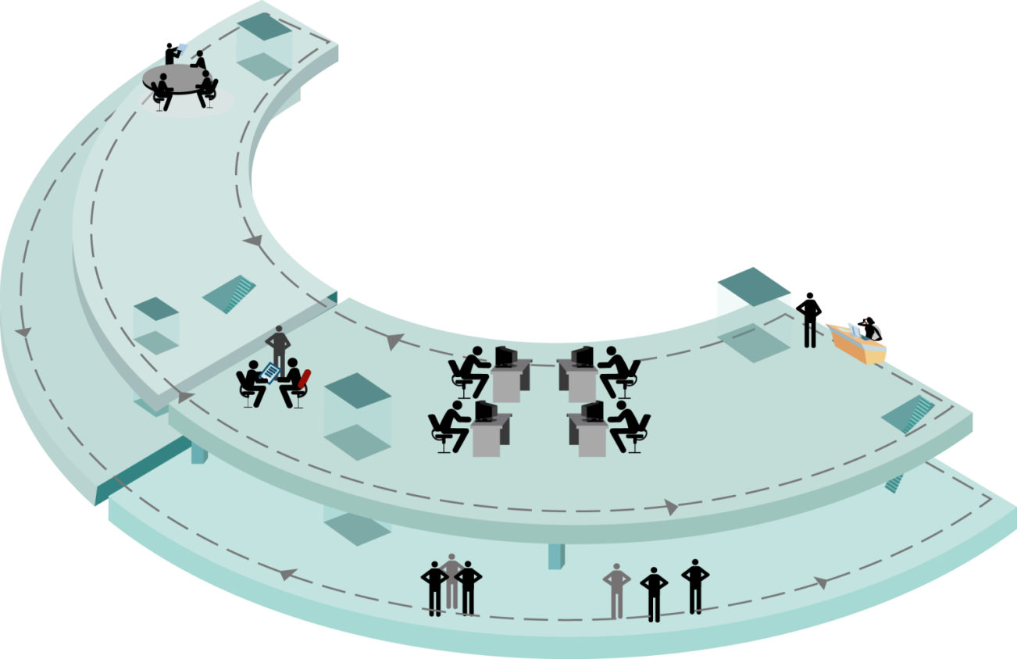
IT Asset Management interfaces
Communication
Communication
Customer
Cloud and Services
IT Strategy
IT Portfolio
Contract
IT SEAM
Project management
IT HAM
IT SAM
Service desk
End-user
Legal
IT PINAM
Acquisition
Financial
ITAM
IT operation
Service Catalogue
Security

Slide 204
IT Asset management interfaces
The concept of IT Asset Management
    IT asset lifecycle

Slide 205
IT Asset Management Interfaces
Five key questions to consider
Do existing IT lifecycle management processes provide outstanding service levels to support core business needs?
Do existing IT Asset Lifecycle management processes provide economics of scale?
Can the organisation govern risk, compliance, and security?
Are you managing the entire lifecycle as a whole, or do you have silos and duplication of work?
Is the current lifecycle solution focused on reducing the Total Cost of Ownership (TCO) of IT Assets while providing the highest business value?

Slide 206
IT Asset Management Interfaces
Stakeholder
Finance
Contract
Legal
Procurement
Manage and control compliance, policies, communication and education
Asset Manager
Software
Hardware
People & information
Cloud & Services
Network specialist
Server specialist
DB specialist
Desktop specialist
Service desk specialist
Day-to-day operation

Slide 207


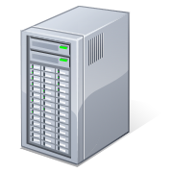


IT Asset Management interfaces
Challenges
IT Asset Manager Challenges
Users
Synchronise
IT specialist
IT Asset Manager
Install / replace
Access / License
Upload / download
Install / replace
Applications server
Database server
Cloud services
Install / replace / update / patch / Retire
Install / replace / update / patch / Retire
IT specialist

Slide 208
IT Asset Manager interfaces
Awareness and responsibility
From an IT Asset Manager perspective it is important to support the IT specialists, this could be through
Education
Communication
Guidance
IT Asset Manager
The IT specialist needs to be aware of the following, when he/she is carrying out day-to-day operations:
Conditions and Terms
Regulation
Impact/Risk by carrying out day-to-day operations
Policies
Processes and procedures
Harvesting software and licenses when retiring or disposing of hardware
Updated and correct inventory and repository
IT specialist

Slide 209
IT Asset Manager interfaces
Awareness and responsibility
Users should be aware of
Policies, policies, policies
Confidentiality of Information
Users
In perspective of IT users, it is also a IT Asset Manager responsibility to control and manage people and information, which means
Control with user roles and responsibilities
Control with granted user rights to applications and Information
Manage and control track and trace of information
Be compliant with Information Security Management
IT Asset Manager

Slide 210
IT Asset Management interfaces
What to do?
Policies
Define and implement Policies and regulations
Implement process framework
IT Asset Manager
Implement supporting technologies
Communication and training

Slide 211
IT Asset Management interfaces
Critical realistic considerations
Which Tool can do this ?

Slide 212
Quiz 6
What do you remeber?
What is ITAM ecosystem?
    System of processes, functions and stakeholders (both internal and external) needed to be consider to perform successful IT Asset Management

Slide 213
Exam preparation
IT Asset Management interfaces
Question 1:
IT asset management is part of the IT ECO system.
With what process management framework should IT asset management be primarily aligned?
A. To the business lean process model, because this aims a maximizing customer value
B. To the Risk IT framework, as this framework focuses on IT risks based upon business risks
C. To the project in changing environment framework, as projects normally take care of installing or removing assets
D. To the IT Service management framework because this plays a major role in managing and controlling IT assets

Slide 214
Exam preparation
IT Asset Management interfaces
Question 2:
In what way should IT specialists be aware of IT asset management?
A. Consider updated and corrected inventory information
B. Consult the IT Asset manager for standards when deploying a hardware update.
C. Ask the asset manager for a change impact analysis when a change is considered.
D. Make sure that all software is licensed according to the contractual terms.

Slide 215
Exam preparation
IT Asset Management interfaces
Question 3:
The role of an IT Asset Manager has a lot of challenges. What is the biggest challenge for a starting IT Asset Manager?
A. To be compliant and to produce a monthly overview of all IT Assets and their status.
B. To clean up and dispose all overdue IT assets.
C. To get in control of all the IT assets in cooperation with all specialists involved.
D. To organize SAM tooling and to have it installed correctly.

