Slide 1
V3.0
Notes:
The NIS2 Directive is an instruction to EU Member States to create a national law. Directives include much of what the final national laws will contain but leave room for local/national interpretation. To comply with the national laws that will be drafted, you may need to comply with additional requirements included by each individual Member State in their NIS2 derived legislation.
This training focuses on the practical implications of the Directive and what the organizations that must comply with it have to do to meet the Directive’s intent. It is written for members of management bodies, including the information security officer and data protection officer to provide practical guidance to the requirements in the Directive. The training will help you assess and prepare for basic compliance with the Directive in a structured and easily comprehensible manner.
This training is further supported by “The NIS2 Navigator’s handbook: Bridging the cybersecurity gap”. This book expands on many of the topics in the training to give those that will actively pursue NIS2 compliance a further insight into the law and its interpretation. The book also includes a more detailed gap analysis for an even clearer understanding of what needs to be done in your organization for you to become compliant.

Slide 2

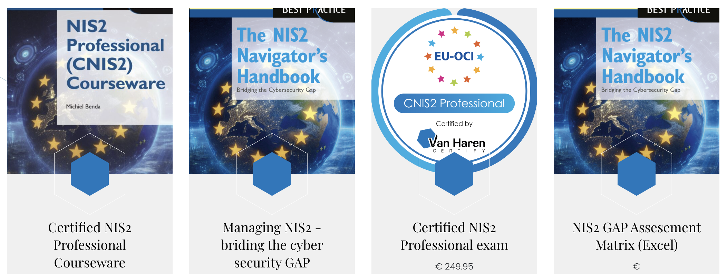
What is NIS2?

Slide 3






Some NIS2 statistics
100k+
Organizations
across the EU
are in scope
72
Types of entities
fall in the scope of
the NIS2
46
Provisions
100+
References to
other laws and
regulations
144
Recitals
€2m
Potential fines

Slide 4
Why this training?
“…the members of the management bodies of essential and important entities are required to follow training…in order that they gain sufficient knowledge and skills to enable them to identify risks and assess cybersecurity risk-management practices and their impact on the services provided by the entity.”
- NIS2, Article 20, paragraph 2
Notes:
Purpose
Management of organizations that fall under the scope of the NIS2 Directive are required to follow training that is sufficient to make informed decisions about the organization’s cybersecurity practices. This training is designed to meet that requirement.
Management time is precious. While training is important, what they probably really want to know is whether they are compliant with the Directive’s requirements. This training is designed to meet both needs.

Slide 5

Unique Selling Points

Slide 6

100% European build training
100% European build exam
100% European certification
Why would we have US
training companies explain EU
law to us?!?!?

Slide 7

A full NIS2 GAP assessment is included
Directly on the participant’s
organization
It includes a full action plan
for all needed remediations
Not just a training. We provide a clear path to compliance

Slide 8

Tally and plot the GAP
606
1000
A.1: Cybersecurity Program
A.14: Control Effectiveness
100
A.2: Risk Management
90
80
A.13: Secure Communications
70
A.3: Policies
60
 | Score |  |  | Score
A.1 | 80 |  | A.8 | 55
A.2 | 94 |  | A.9 | 100
A.3 | 52 |  | A.10 | 18
A.4 | 7 |  | A.11 | 89
A.5 | 27 |  | A.12 | 59
A.6 | 98 |  | A.13 | 21
A.7 | 60 |  | A.14 | 88
50
100
40
100
A.12: Basic Cyber
Hygiene
90
30
90
80
20
80
A.4: Business
Continuity &
Disaster
Recovery
70
70
10
60
60
50
A.11: Access .
Management
50
10
40
40
20
30
A.5: Incident
Management
30
30
20
20
10
10
40
A.10: Cryptography
and Encryption
50
60
A.6: Secure System
Lifecycle Management
70
80
A.9: Asset and Vulnerability Management
90
A.7: Human Resources Security
A.8: Supply Chain Security
100
Notes:
Have participants calculate their scores and create the web graphs. Have each participant calculate the overal score (0-1000). Ideally register these scores anonymously by registering them at the entity types provided in Annex I and II.

Slide 9

We provide all the materials
A complete slidedeck for the training
A courseware manual
The NIS2 Navigator’s Handbook: Bridging the Cybersecurity Gap
An exam with the coveted CNIS2 Professional certification
A train the trainer session

Slide 10
Thank you

